Slide 1
Employee Management SQL Project
Employee Management Database
SQL Project Presentation
Made by :
Pearl Sethi

Slide 2
Project Overview
• Database: EmployeeManagement
• Tool: MySQL Workbench
• Dataset: Employee records

Slide 3
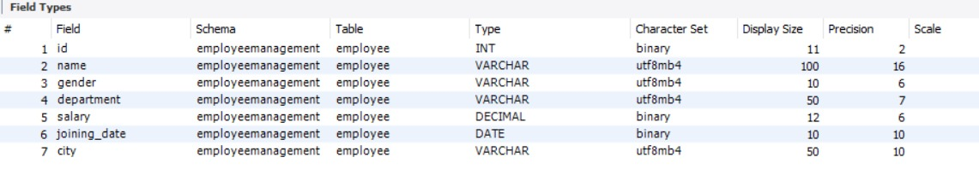
Table Structure
employee table
id, name, gender, department,
salary, joining_date, city

Slide 4
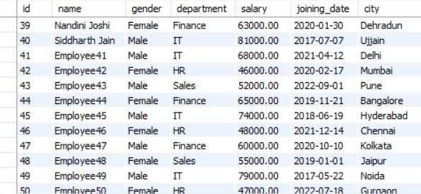
DDL Operations
• CREATE DATABASE
• CREATE TABLE

Slide 5
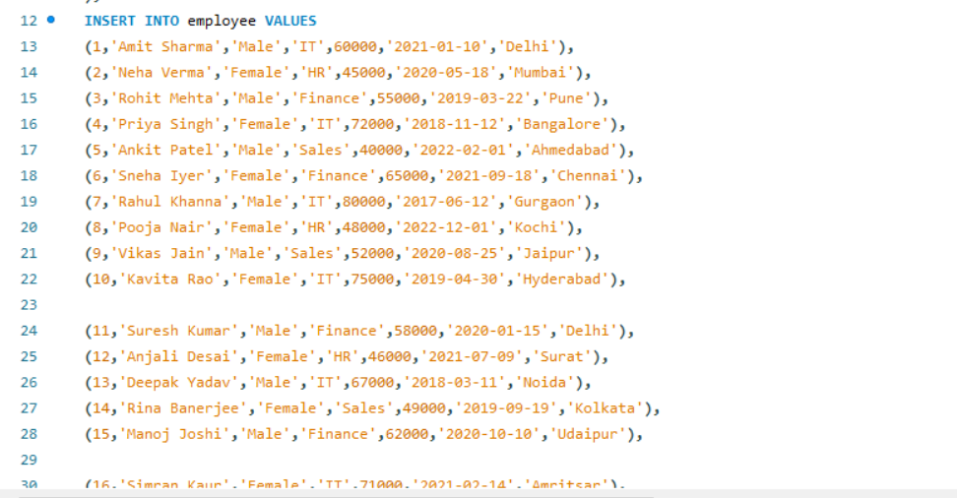
DML Operations
• INSERT employee records
• SELECT queries

Slide 6
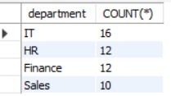

EDA Analysis
• Total employees
• Min, Max, Avg salary
• Department-wise count

Slide 7
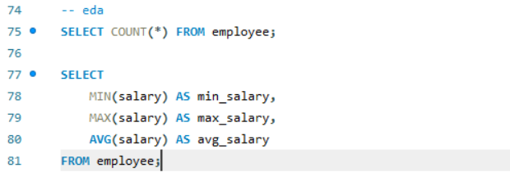
Sample Queries
SELECT COUNT(*) FROM employee;
SELECT AVG(salary) FROM employee;

